Slide 1
Intro to C#
Brian Shelledy
Senior Programmer Analyst
Continental Alloys & Services

Slide 2
The .NET Framework
Free, Cross Platform, Open Source
Developed by Microsoft
First Released 1.0 in 2002
Latest version is 4.7.2
#5 and #7 most Popular Languages are C# and VB.NET (Tiobe Index Dec. 2017)

Slide 3
Why .NET Core?
Free and Open Source
Cross Platform
Supports Console, ASP.NET and Entity Framework
3.0 Version this year will support desktop applications
Fully Contained, no need to worry about what version is installed on target
Supported with Visual Studio Code – also free
PB2018 .NET targets are for .NET Core

Slide 4
Why C#
Popularity – Most popular of all .NET languages
Familiar Syntax – Similar to Java or C++/C
Leverages all the features of the CLR outside of Functional Programming

Slide 5
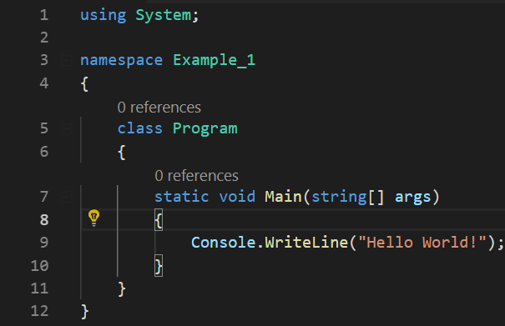
Example: Hello World
using Directive
namespace Declaration
class Definition
function Prototype
statement

Slide 6
.NET Compilation
C#/VB.NET Code
IL Compiler
CIL Bytecode
Common Language Runtime
Machine Code
.NET Native Image Cache

Slide 7
Types in C#
C# is a statically typed language
Variables must be declared
Variables can only contain objects that are assignable to the type they are declared for
C# supports Type Inference
Can use the var keyword and types will be inferred from assignment
Can only use var when doing an assignment
Type is determined by the compiler at compile time, not at runtime

Slide 8
C# Built In Types
Integral Types
Floating Point Types
Non-numeric Types
sbyte (System.SByte) byte (System.Byte) short (System.Int16) ushort (System.UInt16) int (System.Int32) uint (System.UInt32) long (System.Int64) ulong (System.UInt64)
float (System.Single) double (System.Double) decimal (System.Decimal)
bool (System.Boolean) char (System.Char) object (System.Object)* string (System.String)*
*All built-in types are Value Types except string and object.

Slide 9
Value Types vs. Reference Types
Value Types
Reference Types
Always copied by value
Sometimes allocated on stack
Variable contains Data
Always copied by reference
Allocated on Heap
Variable contains Memory Reference
https://blogs.msdn.microsoft.com/ericlippert/2009/04/27/the-stack-is-an-implementation-detail-part-one/

Slide 10
C# and Strings – Example 2
The string type in C# is a special case.
C# strings are immutable reference types
They behave similarly to value types

Slide 11
Arrays in C#
Arrays are dynamically sized
You can specify a default allocation on declaration
They are 0 indexed

Slide 12
C# Flow Control
if/then/else
switch/case/default/break
do while/loop and while/do
for/next
foreach
Notes:
Foreach is used by IEnumerable

Slide 13
Namespaces
Namespaces are used to organize methods and classes into logical groups
Every class should be a member of a namespace
Namespaces can have multiple levels like File Folders

Slide 14
Classes
Basis of Object Oriented Programming
All are derived from System.Object
Contains Fields, Properties and Methods

Slide 15
Access Modifiers
public The type or member can be accessed by any other code in the same assembly or another assembly that references it.
private The type or member can be accessed only by code in the same class or struct.
protected The type or member can be accessed only by code in the same class, or in a class that is derived from that class.
internal The type or member can be accessed by any code in the same assembly, but not from another assembly.
protected internal The type or member can be accessed by any code in the assembly in which it is declared, or from within a derived class in another assembly.
private protected The type or member can be accessed only within its declaring assembly, by code in the same class or in a type that is derived from that class.
The default access modifier for classes and their methods is internal

Slide 16
Properties
Properties are Class members that hide fields
Generally, Properties are public or internal
They implement get and set methods
C# lets you auto implement properties without defining a backing field
You can have different access modifiers for get and set

Slide 17
Inheritance, Interfaces, and Polymorphism
All classes inherit from exactly one object
Classes without a declared ancestor inherit from System.Object
System.Object is the exception to this rule
Classes can implement multiple interfaces
An interface specifies methods that a class that implements it must have
Interfaces cannot contain implementations, though this is changing in C# 8.0 this year
Classes can be assigned to variables with types matching their own or their ancestors or implemented interfaces

Slide 18
Derived Objects
A descendant of an object inherits all Public methods and properties of the base class
They may not have a higher access level then their base class
Methods defined on a derived object are not available when it’s assigned to a variable with it’s base type
Methods of the derived class can override virtual methods or provide new implementations that hide methods from the base class

Slide 19
Virtual, Override, New, base
Descendant objects can provide new implentations for public methods of their base class by specifying the method with the new keyword
New methods hide the old method when calling from references to the derived class, but the base class method is used when calling from references to the base class
Descendant objects can override public virtual methods of their base class by specifying the override keyword
Overridden methods use the derived class’s implementation when the base method is called.

